Slide 1
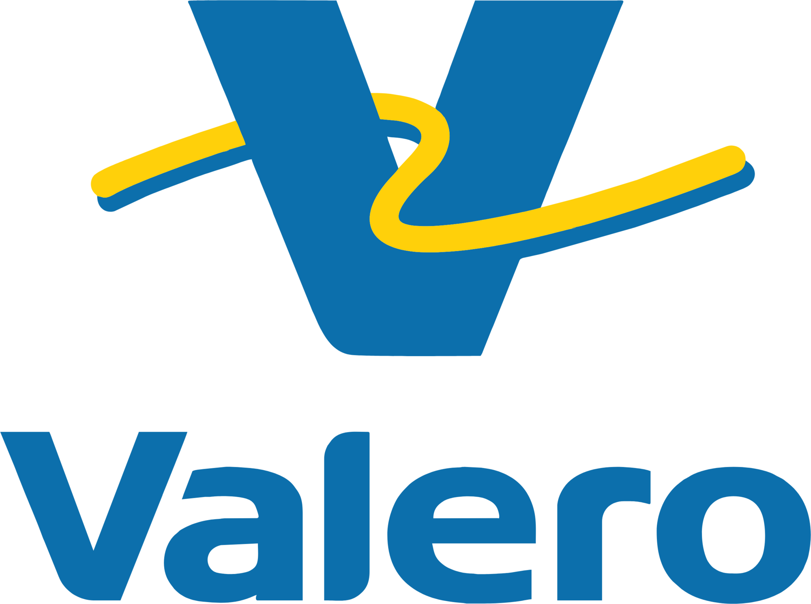
VALERO ENERGY CORPORATION NYSE: VLO
RISK MANAGEMENT STRATEGY
Group 2
Arvind Kumar Gill
Krishna Chaitanya Uppalapati
Ramita Akella
Sridhar Sneha

Slide 2
Overview
Headquarters: One Valero Way, San Antonio
Profile: Fortune 500 Energy Manufacturer – Petroleum Refining & Renewable Fuels
Global Presence: Operations across the U.S., Canada, U.K., Ireland, and Latin America
Asset Portfolio:
Refining: 15 Refineries with approx. 3.2 million barrels per day throughput
Renewable Diesel: World’s 2nd largest producer (approx. 1.2 billion gallons/year) via DGD Joint Venture
Ethanol: 12 plants with 1.7 billion gallons/year capacity
Strategic Focus:
Delivering reliable, affordable, and cleaner energy through operational excellence and low-carbon innovation.

Slide 3

Crude Oil Characteristics
Crude oils are blends of hydrocarbon molecules
Classified and priced by density, sulfur content and acidity
Density is commonly measured in API gravity (relative density of crude oil to water)
API > 10: lighter, floats on water
API < 10: heavier, sinks in water
Sulfur content is measured in weight percent
Less than 0.7% sulfur content = sweet
Greater than 0.7% sulfur content = sour
Acidity is measured by Total Acid Number (TAN)
High acid crudes are those with TAN greater than 0.7
Acidic crudes are corrosive to refinery equipment and require greater investment to process significant volumes
Heavy, sour, high acid crude oils are more difficult to process, but trade at a discount relative to light, sweet, low acid crudes oils

Slide 4



Crude Oil Reserves and Quality
1.73 Trillion Barrels of Oil Reserves (2020)
Sour
Crude Oil Quality
Majority of global reserves are sour crude oils
Asia Pacific 2.6%
4.0
Maya
Africa 7.2%
WCS
Basrah
Cold Lake
Canada 9.7%
U.S. 4.0%
3.0
Merey
Sulfur, wt%
Arab Medium
Mexico 0.4%
Napo
Southern Green
Middle East
48.3%
South & Central America 18.7%
2.0
Castilla
Arab Light
Mars
WTS
WTI and Brent are the primary light sweet crude oil pricing benchmarks
Oriente
Eagle Ford
1.0
ANS
Bakken
WTI
Midland
WTI Light
Russia 8.4%
Europe 0.8%
Dalia
Brent
Sweet
0.0
10
20
30
40
50
60
Heavy
Light
Source: Valero and industry reports.

Slide 5

Crude Oil Discounts Relative to ICE Brent
0%
-3%
-5%
-5%
-10%
-13%
-15%
Light Sweet
-20%
Medium Sour
Heavy Sour
-25%
2012
2013
2014
2015
2016
2017
2018
2019
2020
2021
2022
2023
2024
Source: Argus. ASCI represents Argus Sour Crude Index.

Slide 6

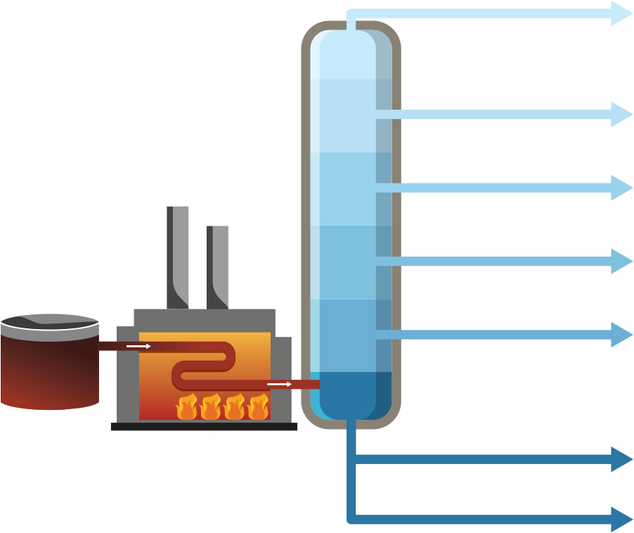








Basic Refining Concept
Intermediates
Final Products
Fuel Gas Propane NGLs Gasoline Gasoline Petrochemicals Kerosene Jet fuel Diesel Gasoline Diesel Gasoline Diesel Gasoline Diesel Coke
C1 - C4
Light Ends Recovery & Treatment
Natural Gas Propane Butane
Crude Distillation
Unit
(Atmospheric)
< 90°F
90–
220°F
C5 - C8
Isomerization / Blending
Distillation Tower
Light Naphtha
220–
315°F
C8 - C12
Reformer / Blending
Heavy Naphtha
315–
450°F
C12 - C30
Hydrotreater
Kerosene
Furnace
450–
650°F
C30 - C50+
Hydrotreater / Hydrocracker
Crude Oil
Diesel / Light Gasoil
C30 - C50+
FCC /
Hydrocracker
Vacuum Distillation Unit
650 - 800°F
Heavy Gasoil
C50 - C100+
Coker / Resid Hydrocracker
+800°F
Residual Fuel Oil
/ Asphalt

Slide 7


Maximizing Refinery Profit – Linear Programming (LP) Model
Relationship between variables are modeled in a series of linear equations
Linear program is used to find combination of feed slate, products, unit operating rates, and operating parameters that delivers highest profit
Feedstocks (100+)
Products (30+)
Prices
Qualities
Availability (purchase volumes)
Prices
Specifications
Market demand (sales volumes)
Refinery
10 to 25+ individual process units
Unit hardware constraints
Operating parameters
Operating costs

Slide 8
Global Low-Carbon Fuel Policies are Driving Demand Growth for Renewable Diesel
 | 2030 GHG Emissions Reduction Target | Net-zero GHG Emissions Target | Primary Transportation Fuel Policy Mechanism | 2030 Transportation Fuels Goal
California | 40% | Net-zero by 2045 | Low Carbon Fuel Standard (LCFS) | Reduce the carbon intensity of transportation fuels by at least 30%
Canada | 40 to 45% | Net-zero by 2050 | Clean Fuel Regulations (CFR) | Reduce the carbon intensity of transportation fuels by 15%
EU | 55% | Net-zero by 2050 | Renewable Energy Directive III (RED III) | Replace 29% of transport fuels with renewable energy, or reduce sector GHG intensity by 14.5%
UK | 68% | Net-zero by 2050 | Renewable Transport Fuel Obligation (RTFO) | Replace 19% of transport fuels with renewable fuels
Oregon | Clean Fuels Program requires a 20% carbon intensity reduction by 2030 and a 37% reduction by 2035
New Mexico | Clean Transportation Fuel Standard, targeting a 20% carbon intensity reduction by 2030
Washington State | Clean Fuel Standard requires a 20% carbon intensity reduction by 2034
British Columbia | Low Carbon Fuel Standard requires a 30% carbon intensity reduction by 2030
Norway | Biodiesel blending mandate of 33% by 2030
Potential Policies | Hawaii, Illinois, Massachusetts, Michigan, Minnesota, New Jersey, New York, Nevada and Vermont are considering low-carbon fuel programs
Up to 80% reduction in life cycle GHG emissions
Cost-effective fuel that can be used with existing vehicles
Drop-in fuel that does not require infrastructure investments

Slide 9


SAF Mandates are Expanding Globally
 | SAF Mandates
CORSIA | Program aims to offset growth in CO2 emission from international aviation above 85% of 2019 emissions. Participation is voluntary over 2021-2026 and becomes mandatory for participating nations starting in 2027
_{EU}(1) | 2% in 2025, 6% in 2030, 20% in 2035, 34% in 2040, 42% in 2045, and 70% in 2050.
Brazil | GHG emission reduction of 1% in 2027, progressively increasing to 10% by 2037, through the use of SAF
France⁽²⁾ | 1.5% in 2024, 2% in 2025 and 5% in 2030
Germany⁽²⁾ | Power-to-liquid (PtL) SAF sub-mandate of 0.5% in 2026, 1% in 2028 and 2% in 2030
Indonesia | 1% in 2027 on international flights, rising to 2.5% in 2030
Malaysia | 1% in 2026, expected to increase to 47% in 2050
Norway | 0.5% in 2020, expected to increase to 30% in 2030
Singapore | 1% in 2026, possibly increasing to 3%-5% in 2030
Sweden⁽²⁾ | 1% in 2021 and increasing to 30% in 2030
UK | 2% in 2025, increasing linearly to 10% in 2030 and then to 22% in 2040
British Columbia | 1% in 2028, 2% in 2029 and 3% in 2030
Potential Policies | Denmark⁽¹⁾, Japan, India, Finland⁽¹⁾, Netherlands⁽¹⁾ and South Korea
⁽¹⁾European Union’s ReFuelEU Aviation regulation
22
⁽²⁾Members of the EU and will be covered by REFuelEU Aviation

Slide 10
Rank of Risks
1️⃣ Commodity & margin volatility 2️⃣ Environmental & climate regulation 3️⃣ Operational interruptions 4️⃣ Renewable fuel program exposure 5️⃣ Extreme weather 6️⃣ Cybersecurity threats 7️⃣ Project execution risks 8️⃣ Labor and workforce constraints 9️⃣ Insurance limitations 🔟 Tax, credit, and JV governance risks

Slide 11
Risk and Risk Categories
Market Risk
Operational Risk
Regulatory and Environmental Risk

Slide 12
Risk Exposure vs. Hedging Intensity (🔵 = Relative exposure; more dots = higher sensitivity)
Risk Type | Refining | Renewable Diesel | Ethanol | Corporate
Commodity Price | 🔵🔵🔵🔵🔵 (High) | 🔵🔵🔵 (Medium-High) | 🔵🔵🔵 (Medium-High) | 🔵 (Low)
Feedstock Cost | 🔵🔵 (Medium) | 🔵🔵🔵🔵 (High) | 🔵🔵🔵 (Medium-High) | —
RIN / LCFS / Carbon Credit | 🔵🔵🔵 (Medium-High) | 🔵🔵🔵🔵 (High) | 🔵🔵🔵 (Medium-High) | —
Interest / FX Risk | 🔵 (Low) | — | — | 🔵🔵 (Medium)
Regulatory / Policy Risk | 🔵🔵 (Medium) | 🔵🔵🔵🔵 (High) | 🔵🔵 (Medium) | 🔵 (Low)
Operational / Supply Chain | 🔵🔵🔵 (Medium-High) | 🔵🔵 (Medium) | 🔵 (Low) | —

Slide 13
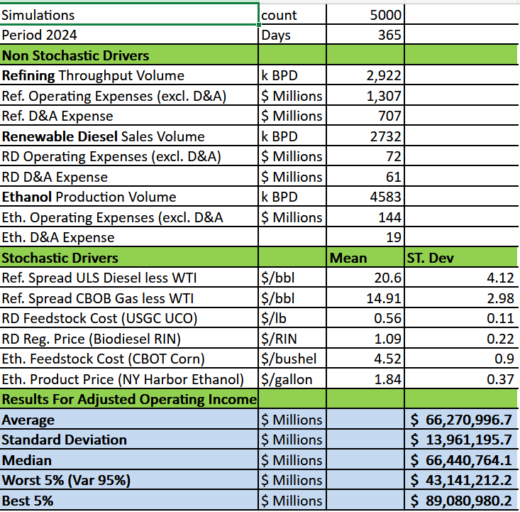
Market Risk Drivers

Slide 14
Operational Risk
Variability in utilization affecting throughput and production levels
Inventory fluctuations impacting working‑capital requirements
Accounts Payable volatility creating short‑term liquidity pressure
COGS variability affecting operational margins and earnings stability

Slide 15
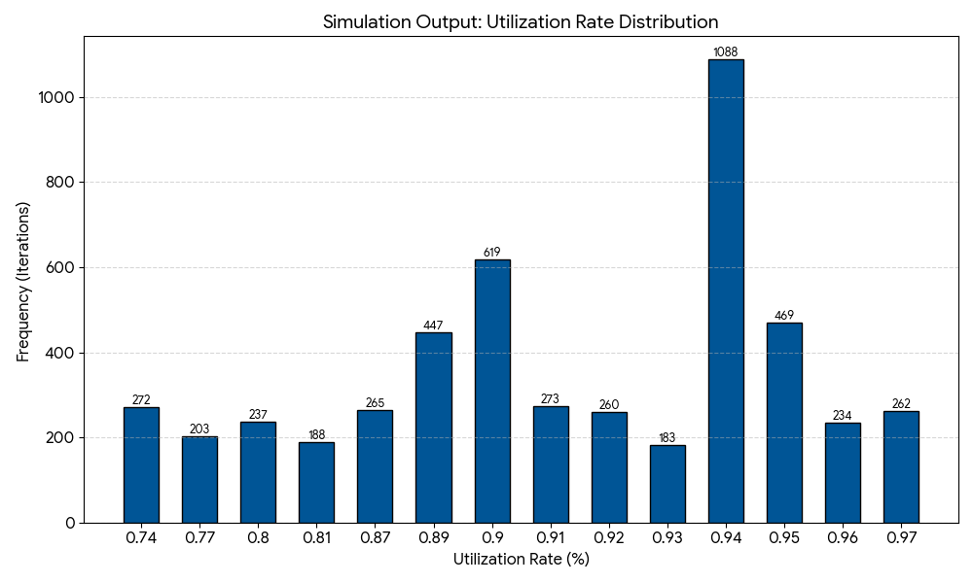
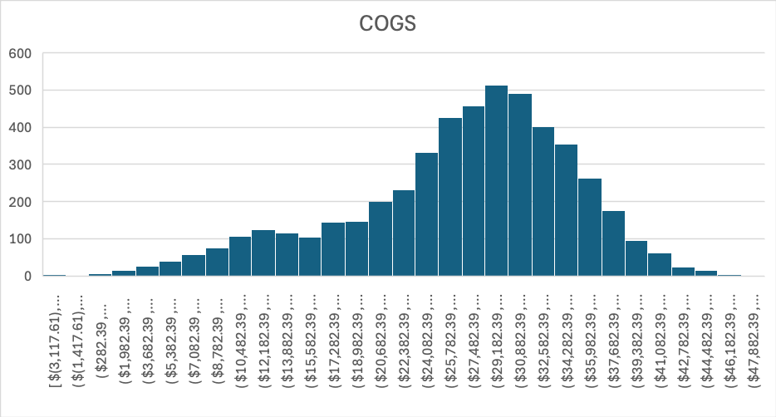
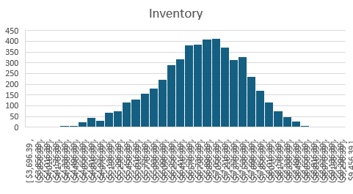
Stochastic Modeling: Utilization, Cost, and Inventory

Slide 16
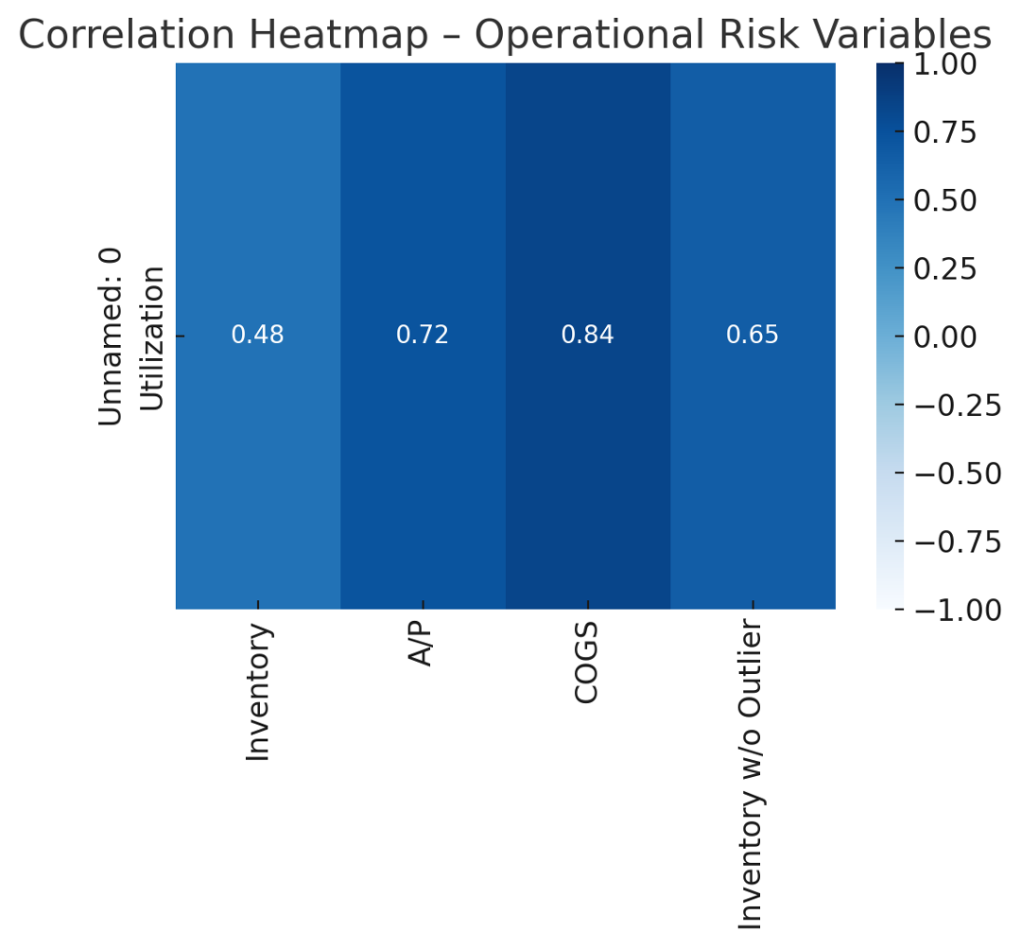
Sensitivity Analysis

Slide 17
Regulatory Risk
What is Regulatory Risk?
The potential for changes in laws, regulations, or government policies to adversely affect a company's operations, profitability, or asset values. For refiners like Valero, this risk is concentrated in environmental and climate policy.
Regulations directly dictate what products can be sold and create entirely new markets.
Key Regulatory Risk Drivers in Low-Carbon Fuels:
RIN (Renewable Identification Number): A compliance credit under the U.S. Renewable Fuel Standard (RFS). Obligated parties (refiners) must blend biofuels or purchase RINs. Price volatility directly impacts compliance costs.
LCFS (Low Carbon Fuel Standard): A California (and other states) program that incentivizes lower-carbon transportation fuels. Generates tradable credits (for low-carbon fuel) and deficits (for high-carbon fuel). Impacts regional market competitiveness.
Carbon Price: The cost of emitting one ton of CO₂, Increases the cost of operating fossil-intensive assets.

Slide 18
Industry-Wide Impact of Risk Drivers
These drivers collectively reshape the competitive landscape and asset economics:
RINs: Increase operating costs for merchant refiners without integrated blending. Incentivize renewable fuel blending and investments. Create a wealth transfer between obligated and non-obligated parties.
LCFS: Drives investment in low-carbon fuel production (renewable diesel, biofuels) and feedstock innovation (e.g., used cooking oil). Penalizes conventional fuels, favoring assets in non-LCFS regions or those adapted to produce credits.
Carbon Price: Makes emissions-intensive processes more expensive, eroding margins for traditional refining. Accelerates asset stranding of high-carbon assets and mandates capital allocation towards decarbonization.
Net Effect: These policies disproportionately impact refiners with high-carbon, conventional asset bases, forcing a strategic pivot or facing sustained margin pressure.

Slide 19
Direct Impact on Valero’s Balance Sheet
The volatility and directional trend of these drivers manifest on Valero’s balance sheet in three critical areas:
1. PPE Impairment (Property, Plant & Equipment):
Connection: Sustained low RIN/LCFS credit prices or a high carbon price reduce the long-term forecasted cash flows from certain conventional refineries or units.
Impact: This can lead to a write-down of asset book value if future discounted cash flows fall below carrying value. Assets in regions with strict regulations (e.g., California) are particularly at risk.
2. Operating Income (P&L, flowing to Retained Earnings on Balance Sheet):
Connection: RIN purchase costs and LCFS deficit costs are direct operating expenses. Sharp price spikes compress quarterly gross margins.
Impact: Increased volatility and potential long-term pressure on profitability, reducing net income and, consequently, retained earnings (an equity account on the balance sheet).
3. Asset Retirement Obligations (ARO):
Connection: A rising carbon price and stringent regulations can accelerate the planned closure of uneconomic units or entire sites.
Impact: This may necessitate an increase in the ARO liability (a long-term debt-like obligation) as the timing and cost of future decommissioning are brought forward and re-estimated.

Slide 20
The Role of Monte Carlo Simulation
Why a 3-Step Monte Carlo? To Move from Qualitative Risk to Quantitative Exposure.
Model Driver Uncertainty: Simulate thousands of possible future paths for RIN, LCFS, and Carbon Prices based on historical volatility, policy scenarios, and correlation.
Translate to Financial Impact: Model how each simulated price trio affects cash flows, asset valuations, and compliance costs at the asset/operating level.
Quantify Balance Sheet Impact: Aggregate results to produce a probability distribution of potential impacts on:
PPE Values (Range of potential impairment charges)
Future Operating Income (Margin distribution)
ARO Liabilities (Potential increase in present-value obligation)
Outcome: Provides a probabilistic view of regulatory risk exposure, informing future capital allocation, hedging strategies, and impairment testing assumptions.

Slide 21
Strategic Imperatives for Regulatory Risk Management
Ultimate Goal: Transform regulatory risk from a cost center into a managed source of competitive advantage, ensuring Valero’s balance sheet and strategic trajectory remain robust under any plausible policy future.
Strategic Recommendations for Regulatory Risk Decisions:
Adopt a Probabilistic Planning Framework
Double Down on the Integrated Hedge Strategy:
Proactive Portfolio Management:
Active Policy Engagement & Scenario Monitoring

Slide 22
Regulatory Risk Drivers
Compliance Exposure
Number of credits Valero must retire annually.
Driven by fuel production volume + carbon intensity.
Credit Price Volatility
RIN and LCFS prices fluctuate due to policy changes and market conditions.
Internal Offsets
Credits generated internally (mainly through Diamond Green Diesel).
Reduce the amount of credits purchased externally.
Pass-Through (%)
Portion of compliance cost passed on to customers via fuel pricing.

Slide 23
Simulation Model Structure
Monte Carlo Framework:
Randomly simulate credit price values.
Multiply by compliance exposure → Gross Compliance Cost.
Subtract Internal Offsets and Pass-Through → Net Compliance Cost.
Record Net Compliance Cost as Operating Expense (EBIT ↓).
Convert net cost into Cash Outflow using:
Cash Outflow = Net Compliance Cost ×(1–Accrued Fraction)
Cash outflow reduces CFO → Cash Balane.
Focus: Operating Income Impact + Cash Flow Impact only.

Slide 24
Financial Statement Flow
Income Statement
Net Compliance Cost → increases operating expenses.
Operating Income (EBIT) decreases accordingly.
Cash Flow Statement
Paid portion of cost directly reduces Cash Flow from Operations (CFO)
Balance Sheet
CFO reduction flows into lower ending Cash balance
Accruals not modeled here (intentionally simplified).
Modeling choice: Focus on the two most immediate pressures: Profitability and Liquidity

Slide 25
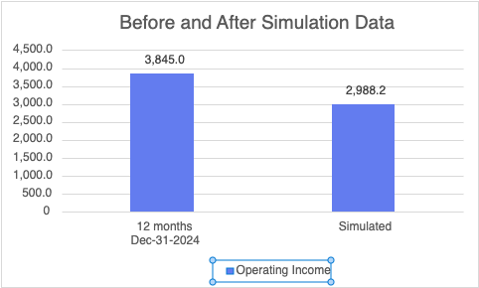
Impact on Income Statement
Operating Income drops from $3,845M in 2024 to $2,988.2M (Approx 21% decline)
Market Risk: Crack spread compression & price volatility reduce margins
Regulatory Risk: Higher RIN/LCFS compliance increases COGS
Combined market plus regulatory risks reduces EBIT by approximately 21%

Slide 26
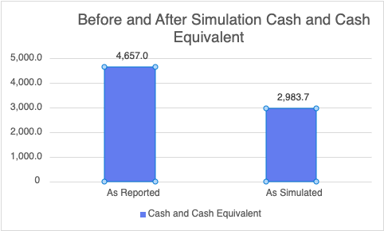
Impact on Balance Sheet
Margin compression from market risk reduces cash generated
RIN/LCFS compliance cost increases reduce CFO
Operating income falls → CFO falls → Cash falls

Slide 27
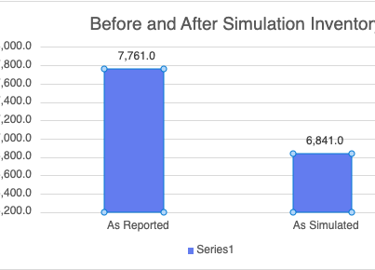
Impact on Balance Sheet
Utilization decrease → reduced refining throughput
Lower input volume → lower ending inventory

Slide 28
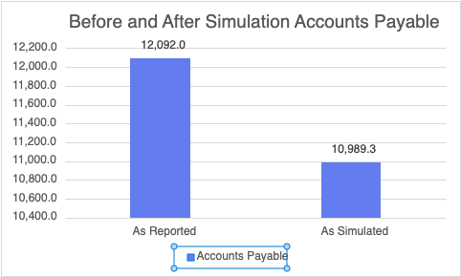
Impact on Balance Sheet
Lower utilization → fewer crude purchases
Reduced purchasing → lower supplier payables

Slide 29
Scenario Analysis – Income Statement
The weighted simulation applies 70% to the Base Case, and 15% each to the Best- and Worst-Case scenarios.
The Normal/Base Case scenario shows OI stabilizing slightly above the weighted value, around $3.13B
The Best-Case scenario improves Operating Income to approximately. $3.3B, indicating upside potential if spreads strengthen and compliance costs ease.
The Worst-Case scenario declines to Approx. $2.8B, highlighting vulnerability to margin compression and regulatory cost spikes

Slide 30
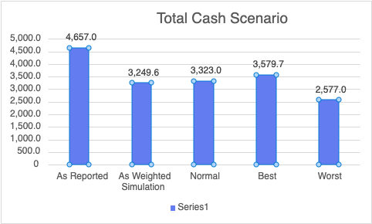
Scenario Analysis – Balance Sheet
Total Cash decreases across all scenarios as Market and Regulatory risks reduce operating margins and increase compliance costs.
The Weighted and Normal cases show a 25–30% drop from reported levels, indicating sustained pressure on cash generation.
Worst Case shows the sharpest decline, reflecting the combined impact of weaker crack spreads and higher RIN costs on liquidity.

Slide 31
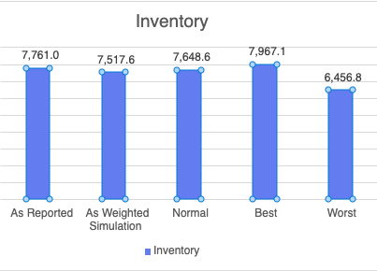
Scenario Analysis – Balance Sheet
Inventory levels move directly with utilization: higher utilization (Best Case) increases production and raises inventory, while lower utilization (Worst Case) reduces output and lowers inventory.
The Weighted and Normal scenarios show inventory staying close to current levels, indicating only moderate changes to operational throughput.
Worst Case shows the sharpest decline in inventory due to a significant drop in utilization, reflecting reduced refinery activity and lower production volumes.

Slide 32

Recommendations
Expand
Expand renewable diesel capacity → higher internal offsets.
Strengthen
Strengthen pricing models to improve pass-through recovery.
Maintain
Maintain a liquidity buffer to manage high-credit-price years.
Use
Use Monte Carlo simulation in budgeting to plan for volatility.
Establish
For Liquidity: Establish a $6B Revolving Credit Facility to bridge the liquidity gap identified in the P5 scenario (dropping from $11.4B to $5.4B).
Prioritize
For Volatility: Prioritize Predictive Maintenance CapEx. Reducing the Utilization Standard Deviation by just 1% (from 6.3% to 5.3%) creates a 4x stabilizing effect on earnings.
Decouple
For Inventory: Decouple Safety Stock logic. The model proves Inventory creates independent risk during crises; we need a static buffer that ignores the Utilization signal during outages.

Slide 33
Questions and Answers

Slide 34

Cautionary Statement
This presentation contains forward-looking statements made by Valero Energy Corporation (“VLO” or “Valero”) within the meaning of federal securities laws. These statements discuss future expectations, contain projections of results of operations or of financial condition or state other forward-looking information. You can identify forward-looking statements by words such as ”plan,” “should,” “anticipate,” “believe,” “estimate,” “expect,” “could,” “continue,” “focused,” “opportunity,” “scheduled,” “may,” “targeting,” or other similar expressions that convey the uncertainty of future events or outcomes. Forward-looking statements in this presentation include, but are not limited to, those relating to our low-carbon fuels strategy, future capital expenditures, expected timing, cost, and performance of projects, the effect of projects on our financial performance, future low-carbon policies, future business plans and strategies, future safety and environmental performance, future production and manufacturing ability and size, and future operating and financial performance. These forward-looking statements are not guarantees of future performance and are subject to risks, uncertainties and other factors, some of which are beyond the control of Valero and are difficult to predict including, but not limited to, the effect, impact, potential duration or other implications of the uncertainties that remain with respect to current or contemplated legal, political or regulatory developments that are adverse to or restrict refining and marketing operations, or that impose taxes or penalties on profits, windfalls, or margins above a certain level, global geopolitical and other conflicts and tensions, the impact of inflation on margins and costs, economic activity levels, and the adverse effects the foregoing may have on Valero’s business plan, strategy, operations and financial performance. These statements are often based upon various assumptions, many of which are based, in turn, upon further assumptions, including examination of historical operating trends made by the management of Valero. Although Valero believes that the assumptions were reasonable when made, because assumptions are inherently subject to significant uncertainties and contingencies, which are difficult or impossible to predict and are beyond its control, Valero cannot give assurance that it will achieve or accomplish its expectations, beliefs or intentions. When considering these forward-looking statements, you should keep in mind the risk factors and other cautionary statements contained in Valero’s filings with the Securities and Exchange Commission, including Valero’s annual report on Form 10-K, quarterly reports on Form 10-Q, and other reports available on Valero’s website at www.valero.com. These risks could cause the actual results of Valero to differ materially from those expressed or forecasted in any forward-looking statement.
32

